Slide 1
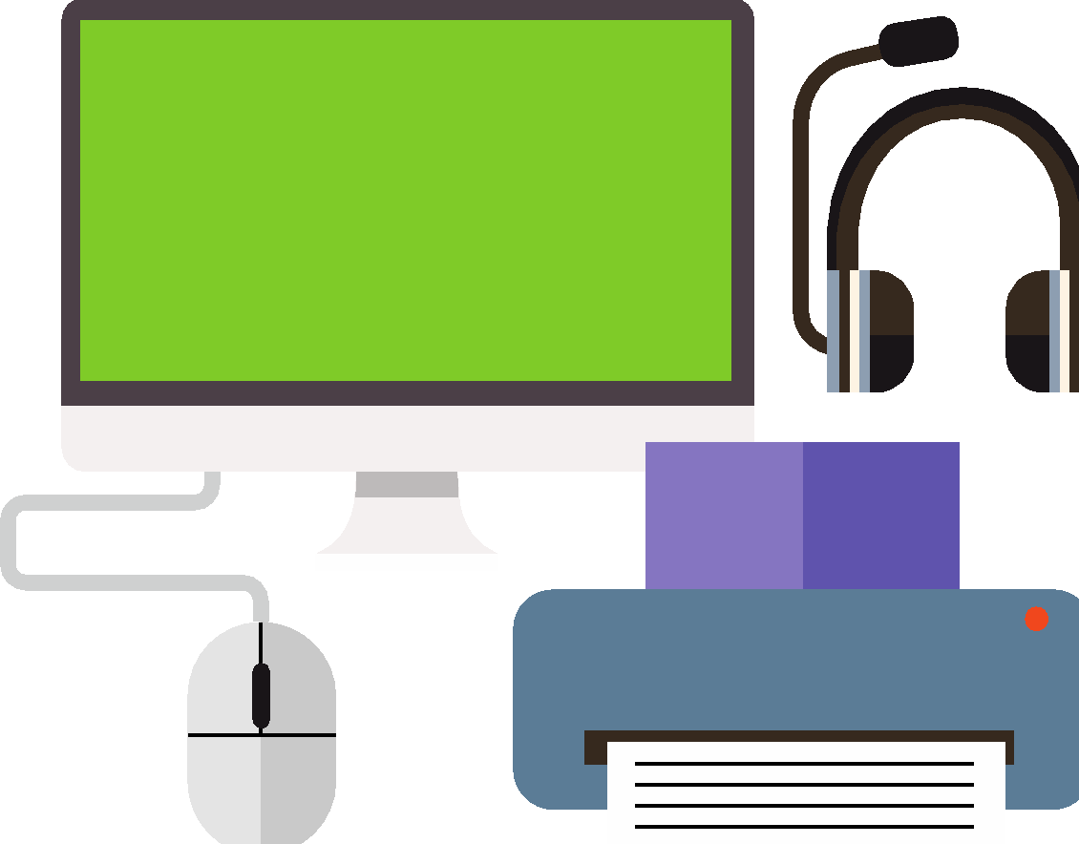
Computing components
Lessons 5 and 6: The Internet of Things

Slide 2
Objectives
In this lesson, you will learn how to:
identify the different IoT devices available
explain how IoT devices can be used with sensors to create automation
discuss the benefits and drawbacks of IoT devices.

Slide 3
Internet of Things devices
An Internet of Things (IoT) device is a device that connects to the internet so that it can ‘talk’ to other devices.
An IoT device collects data, analyses it and, if appropriate, automates a process by talking to another IoT device.
IoT devices in the home are often referred to as ‘smart’ devices, but IoT devices are used in factories and other industries too.

Slide 4
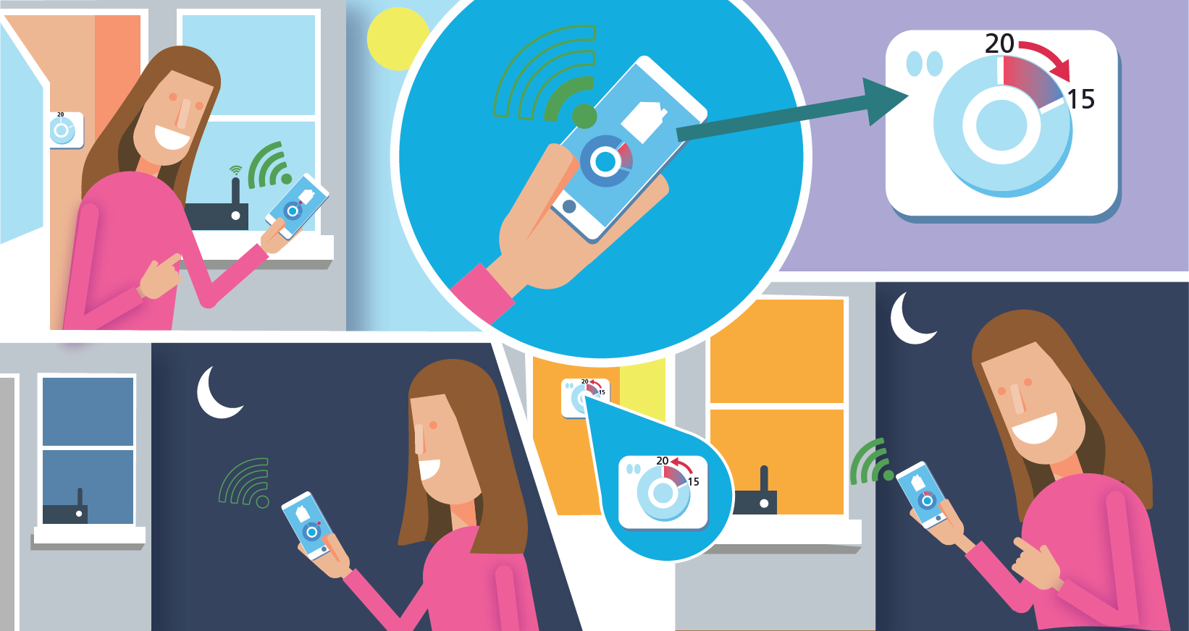
IoT in action
Here is an example of how IoT devices work together to automate processes.

Slide 5

Activity 5.1: For or against?
IoT devices have benefits and drawbacks.
Construct an argument FOR or AGAINST the use of IoT devices.
Remember, regardless of whether you are arguing FOR or AGAINST IoT devices, you need to consider the benefits and drawbacks to create an effective argument.

Slide 6
IoT and data input
The data that enables IoT devices to make decisions and automate processes is collected by input devices.
Keyboards collect data when text or numbers are input.
Microphones collect data when speech or other sounds are detected.
Temperature sensors collect data on how warm or cold an area is.
Light sensors collect data on how much light there is in an area.
Motion sensors collect data on movements in an area.
Pressure sensors collect data on the force being applied to a device.
GPS collects data on the location of a device.

Slide 7
IoT and data input
Once data that has been collected, the IoT device uses it to make a decision.
There are three parts to the decision-making process.
Trigger(s): the data collected by the input device
Condition(s): what the data has to be for the action to be performed.
Action(s): the output if the condition is met.
You can compare the decision-making process of an IoT device with an IF statement in spreadsheets: IF this data is captured, do this.

Slide 8
Activity 5.2: Automation

Slide 9
Activity 5.3: Automating a home

Slide 10
Activity 5.5: IoT devices and the environment
In pairs or small groups, discuss the following question:
How could the automation you designed for your smart home help the environment?

